Slide 1
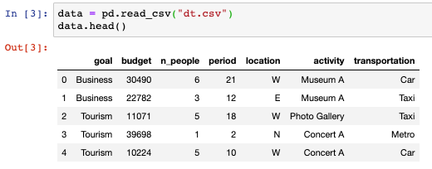
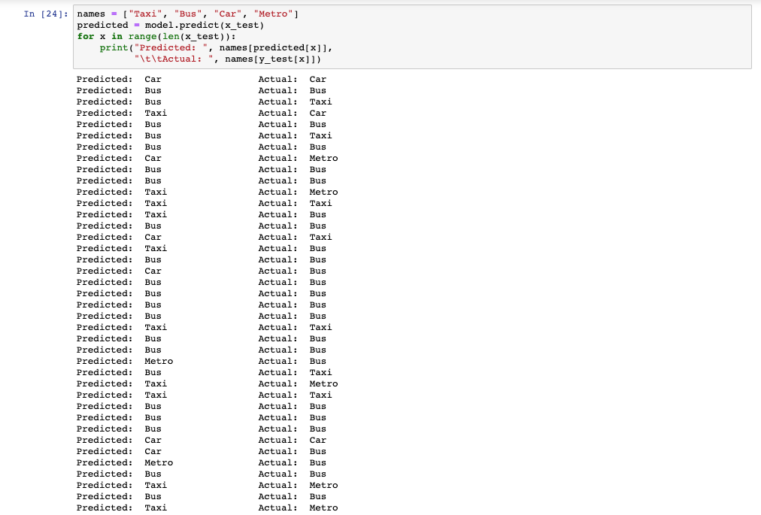
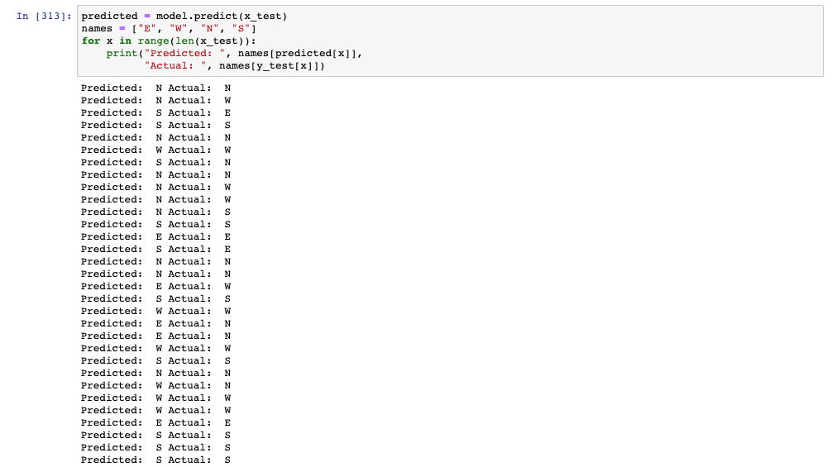
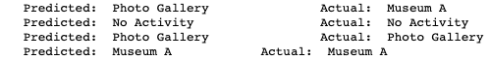
Machine Learning Part
Dataset
The dataset includes 500 rows, 7 columns (goal, budget, n_people, period, location, activity, transportation).
Assumptions:
1- Assuming the activities provided based on the interest of the visitor witch was ( Art ), (Museum A, Concert A, Photo Gallery), A represents the name of the activity
2- Assuming the number of people represents adult people (Not including kids)
3- Assuming the regions of the city are S, N, E, W
Training and Testing
Predict the best transportation way with accuracy around 63%
Inputs :
1- period (number of days)
2- budget
Output : (Taxi, Bus, Metro, or Car)
Predict the best location to stay in with accuracy around 70%
Inputs :
1- Goal (Tourism or Business)
2- budget
Output : (North, South, East, West)
Predict some activities with accuracy around 60%
Inputs :
1- location (North, South, East, West)
2- budget
Output : (Concert, Museum, or Photo Gallery)

